Slide 1
Meeting of the Triglav Circle THE ROLE OF “NATURE”IN THE POLITICS OF THE ENVIRONMENT Neuchatel, Switzerland June 14-15, 2014

Slide 2
What’s Happening at the Bottom of the Pyramid J. Dirck Stryker

Slide 3
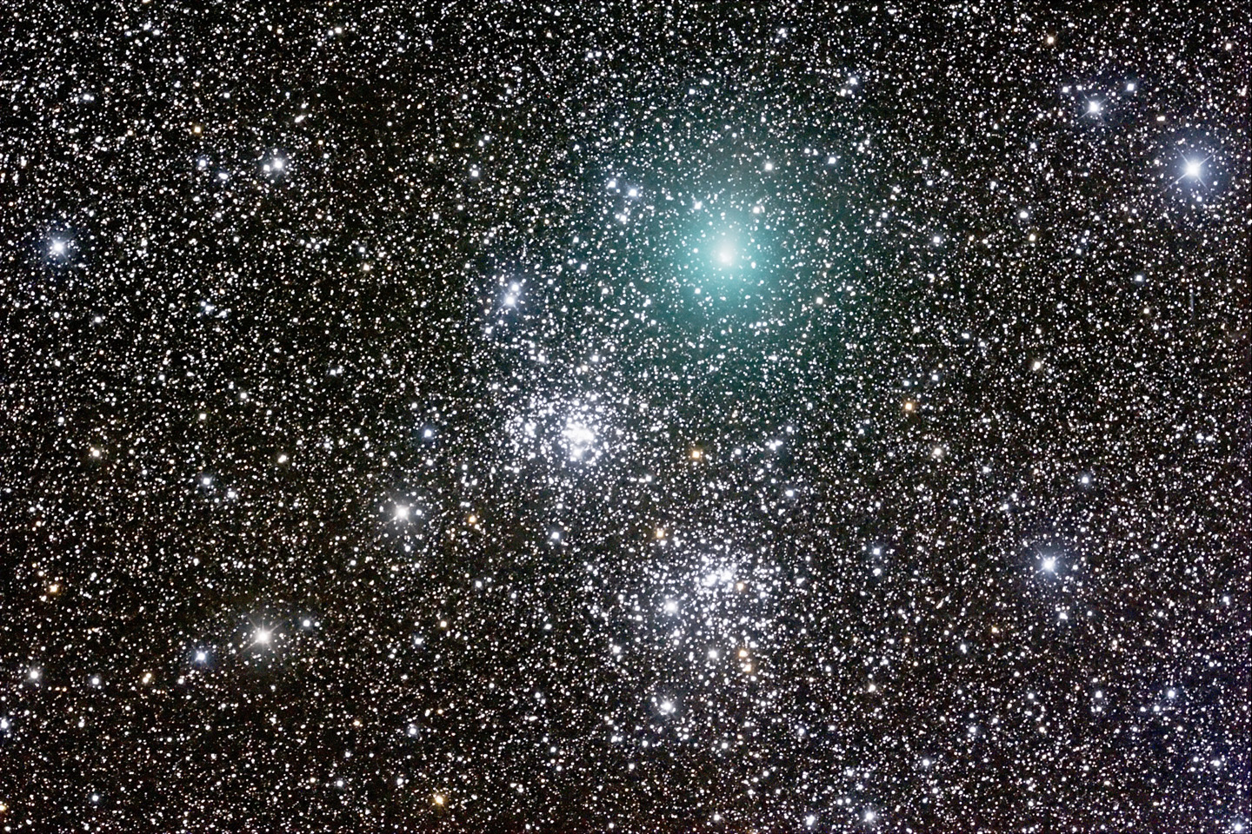
What Do We Mean by Nature?

Slide 4
De rerum natura (On the Nature of Things)
Poem by the Roman Lucretius (c. 99 BC – c. 55 BC), which describes a universe filled with atoms, with their particular form arranged and rearranged over and over again by chance
Later learned that the evolution of the universe is much more purposeful and creative (Brian Swimme and Thomas Berry, The Universe Story) according to a few fundamental principles:
Differentiation towards ever increasing complexity
Autopoiesis towards self-fulfillment
Increasing web of interdependency

Slide 5
Nature is the Universe
And we are the universe. We are part of this creative process. We are the elements, atoms, molecules, energy, organization, entropy, information, whatever you want to call it that the universe is made up of. The universe is not out there and we are here. We are the universe. We have identities that we call ourselves for a time, but they are only fleeting appearances. Ultimately, we are all part of the wholeness that is the universe. We are all interconnected. We are one.

Slide 6
Humans Exploit Nature
Protect the environment for what? Mankind’s continuing and sustained exploitation?
But we are part of nature
We have evolved and will continue to evolve as part of nature.
Humans have a different but not the only kind of intelligence, e.g., Daniel Kahneman’s Thinking Fast and Thinking Slow
System 1
System 2

Slide 7
Overriding Challenge
We have benefitted from the gains of private property ownership and individual appropriation of rewards
But we have failed to a large extent at the community level
Horrendously destructive wars
Global climate change
Growing inequality

Slide 8
Overriding Challenge
Gap between private returns and social returns
Tragedy of the Commons
Problems are easier to resolve the smaller and more homogeneous the community
Shared values
Simpler process of decision-making
Consciousness of collateral effects

Slide 9
What Result if Follow Current path?
Soil degradation and erosion
Chemical contamination and pollution of air and water supplies
Increasing traffic congestion in urban areas
Inability to service dispersed rural communities with transport and electricity
Deterioration of renewable and nonrenewable energy supplies
Smoke inhalation killing millions each year
Lack of light limiting education

Slide 10
Lessons from Bottom of the Pyramid
How to define the bottom
% of world’s population below poverty line
Up to 50% suffer from chronic malnutrition
Up to 50% lack clean water
1.8 billion people lack access to electricity except for batteries
2.4 billion people use wood fuels for cooking
Poor access to transport infrastructure
Low levels of technology

Slide 11
Lessons from Bottom of the Pyramid
How do they cope?
Diversify sources of income, e.g., off-farm labor, non-agricultural goods and services
Invest in assets they can sell in periods of stress, e.g., livestock
Human and animal power for transport
Fuel efficient stoves
Biogas from manure
Substitute cell phone communication for transport and broadband internet connection
Solar panels to charge cell phones and increasingly for light

Slide 12
Fuel-Efficient Wood Stove

Slide 13
Provides Warmth as Well as Coffee Roasting

Slide 14
Bringing Home Housing Materials

Slide 15
Getting Firewood to Market

Slide 16
Lessons for Preservation of Nature
Think small and decentralized to avoid different value systems, over- centralization of process for decision making, lack of awareness of collateral effects
Make use of “soft footprint” modern technology
Stimulate local entrepreneurship
Learn from what is already being done
Create shared values across smaller communities via internet, media, etc.
Work with the digital age as an opportunity

Slide 17
Business Model
Business model of The Fortune at the Bottom of the Pyramid:
Combine external technology and technical services with local entrepreneurship
Keep technology as simple as possible
Sell product in small units for cash
Focus on private profitability based on achieving economies of scale and charging low fees to cover low long-run unit cost
Require initial seed capital but goal is to become purely commercial – avoid recurrent subsidies
Understand local market and what is needed – tailor the product to this market

Slide 18
Constraints
Major constraint is lack of knowledge of what is possible and linking foreign expertise and technology with local entrepreneurship
Once successful, problem of convincing sources of finance that commercially viable
Other constraints may arise as increase scale
Problem of excessive dependence on a particular product or market – need for diversification at some point

Slide 19
Green Economy and Economic Growth
Potential for Green Economy growing via decreased cost of communications, decentralized sources of electrical power, food production
Green Economy tends toward
Local decision-making
Smaller footprint associated with greater economic growth
Greater employment
Greater equality of income and wealth

Slide 20
What Can be Done?
Encourage development and diffusion of clean, smaller-scale technologies
Discourage migration to the cities by developing “green” rural areas
Identify potential for employment in the digital age
Encourage spread of communications as a way of developing shared values while enhancing cultural uniqueness and diversity

